Slide 1
A Guide to SQL, Ninth Edition
Chapter Three
Creating Tables

Slide 2
Objectives
Create and run SQL commands
Create tables
Identify and use data types to define columns in tables
Understand and use nulls
Add rows to tables
©2016 Cengage Learning. All Rights Reserved. May not be copied, scanned, or duplicated, in whole or in part, except for use as permitted in a license distributed with a certain product or service or otherwise on a password-protected website for classroom use.

Slide 3
Objectives (continued)
View table data
Correct errors in a table
Save SQL commands to a file
Describe a table’s layout using SQL
©2016 Cengage Learning. All Rights Reserved. May not be copied, scanned, or duplicated, in whole or in part, except for use as permitted in a license distributed with a certain product or service or otherwise on a password-protected website for classroom use.

Slide 4
Introduction
Structured Query Language (SQL)
  Most popular and widely used language for retrieving and manipulating database data
  Developed in mid 1970s under the name SEQUEL
  Renamed SQL in 1980
  Used by most DBMSs
©2016 Cengage Learning. All Rights Reserved. May not be copied, scanned, or duplicated, in whole or in part, except for use as permitted in a license distributed with a certain product or service or otherwise on a password-protected website for classroom use.

Slide 5
Creating and Running SQL Commands
Oracle Database 11g Express
  Software used in text to illustrate SQL
  Commands will work the same in other versions of Oracle
Differences between Oracle and Microsoft Access and SQL Server are noted in special boxes
©2016 Cengage Learning. All Rights Reserved. May not be copied, scanned, or duplicated, in whole or in part, except for use as permitted in a license distributed with a certain product or service or otherwise on a password-protected website for classroom use.

Slide 6
Using the Oracle Database 11g Express Edition
App loads in your web browser
Must have a DBA database role username and password
Create a workspace
  A work area that allows multiple users to work with the same installation of Oracle
Login to the workspace
©2016 Cengage Learning. All Rights Reserved. May not be copied, scanned, or duplicated, in whole or in part, except for use as permitted in a license distributed with a certain product or service or otherwise on a password-protected website for classroom use.

Slide 7
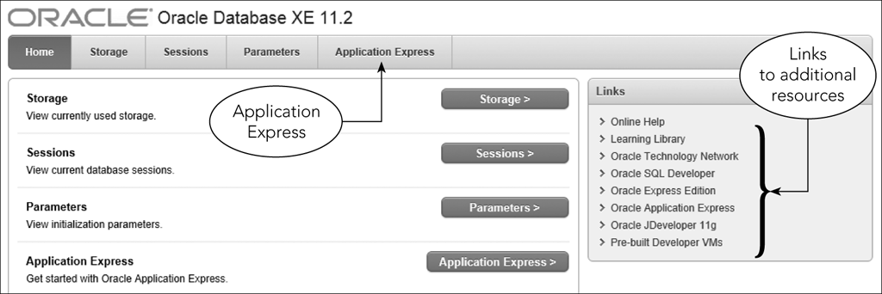
Using the Oracle Database 11g Express Edition (continued)
Figure 3-1: Oracle Database 11g Express Edition home page
©2016 Cengage Learning. All Rights Reserved. May not be copied, scanned, or duplicated, in whole or in part, except for use as permitted in a license distributed with a certain product or service or otherwise on a password-protected website for classroom use.

Slide 8
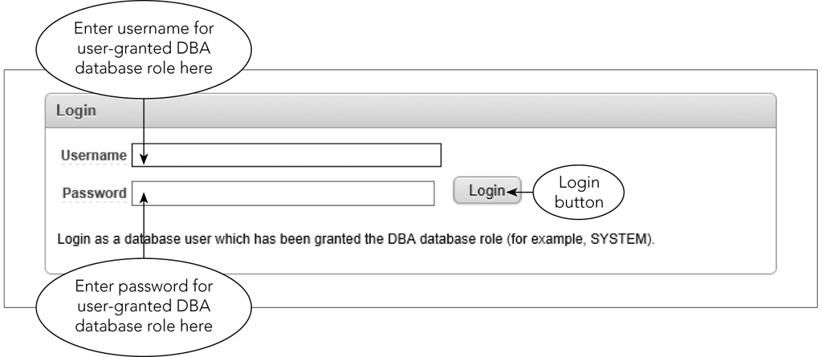
Using the Oracle Database 11g Express Edition (continued)
Figure 3-2: Entering the username and password for a DBA user
©2016 Cengage Learning. All Rights Reserved. May not be copied, scanned, or duplicated, in whole or in part, except for use as permitted in a license distributed with a certain product or service or otherwise on a password-protected website for classroom use.

Slide 9
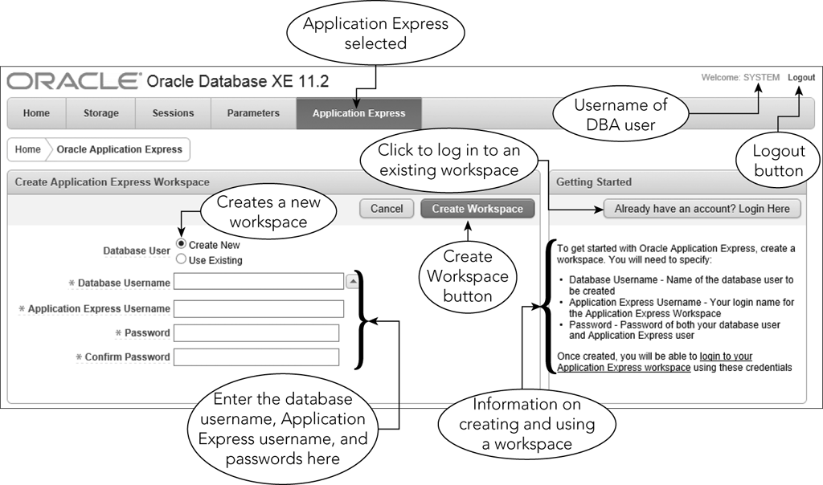
Using the Oracle Database 11g Express Edition (continued)
Figure 3-3: Creating a new workspace
©2016 Cengage Learning. All Rights Reserved. May not be copied, scanned, or duplicated, in whole or in part, except for use as permitted in a license distributed with a certain product or service or otherwise on a password-protected website for classroom use.

Slide 10
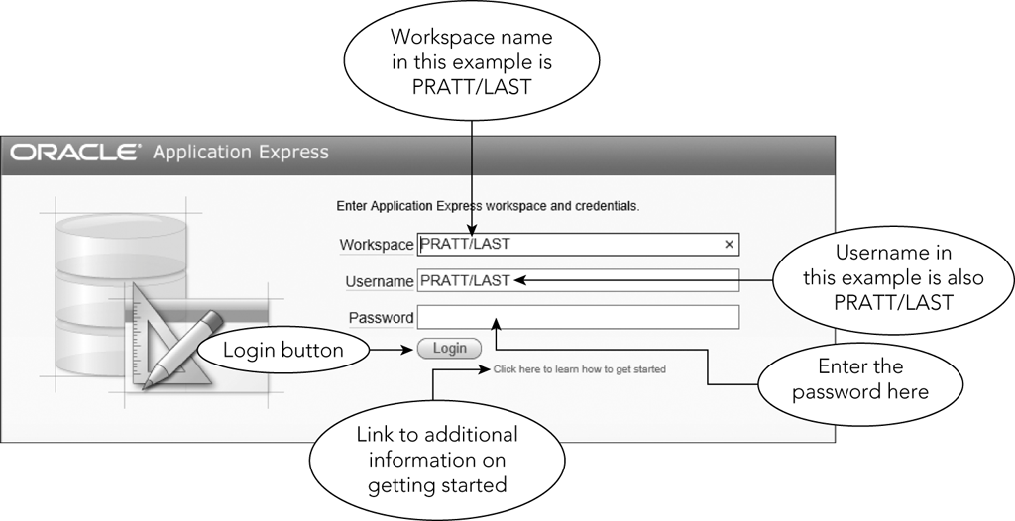
Using the Oracle Database 11g Express Edition (continued)
Figure 3-4: Logging in to an Application Express workspace
©2016 Cengage Learning. All Rights Reserved. May not be copied, scanned, or duplicated, in whole or in part, except for use as permitted in a license distributed with a certain product or service or otherwise on a password-protected website for classroom use.

Slide 11
Using the Oracle Database 11g Express Edition (continued)
Application Express home page provides access to various tools
Use SQL Workshop tool in this text
SQL Scripts page displays scripts
©2016 Cengage Learning. All Rights Reserved. May not be copied, scanned, or duplicated, in whole or in part, except for use as permitted in a license distributed with a certain product or service or otherwise on a password-protected website for classroom use.

Slide 12
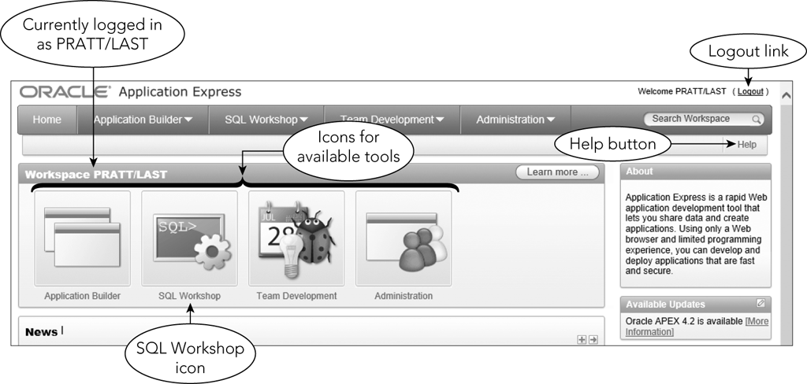
Using the Oracle Database 11g Express Edition (continued)
Figure 3-5: Oracle Application Express home page
©2016 Cengage Learning. All Rights Reserved. May not be copied, scanned, or duplicated, in whole or in part, except for use as permitted in a license distributed with a certain product or service or otherwise on a password-protected website for classroom use.

Slide 13
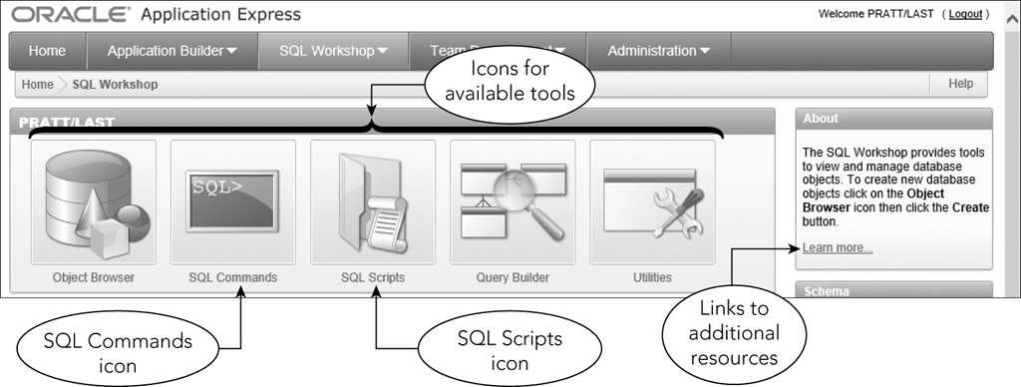
Using the Oracle Database 11g Express Edition (continued)
Figure 3-6: SQL Workshop page
©2016 Cengage Learning. All Rights Reserved. May not be copied, scanned, or duplicated, in whole or in part, except for use as permitted in a license distributed with a certain product or service or otherwise on a password-protected website for classroom use.

Slide 14
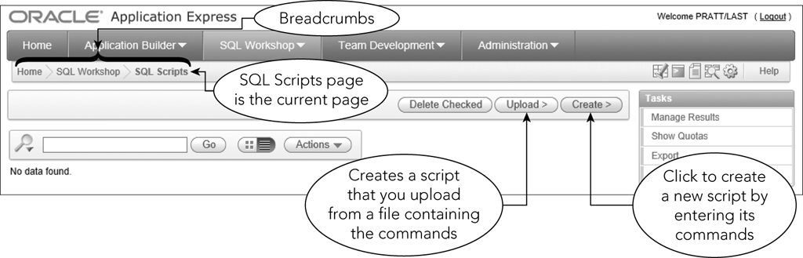
Using the Oracle Database 11g Express Edition (continued)
Figure 3-7: SQL Scripts page
©2016 Cengage Learning. All Rights Reserved. May not be copied, scanned, or duplicated, in whole or in part, except for use as permitted in a license distributed with a certain product or service or otherwise on a password-protected website for classroom use.

Slide 15
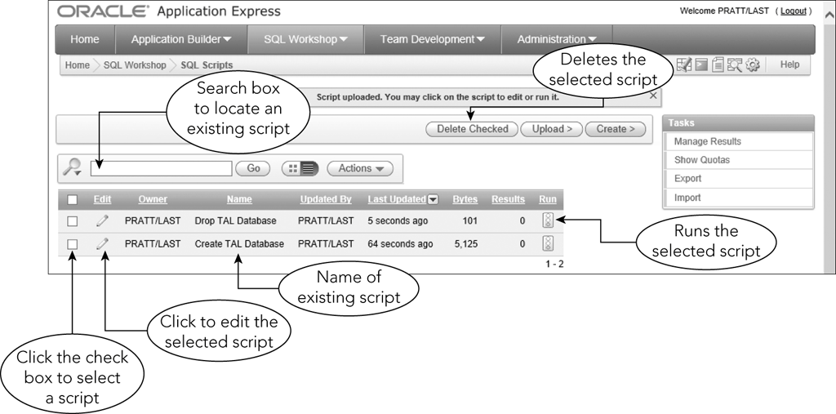
Using the Oracle Database 11g Express Edition (continued)
Figure 3-8: Two scripts displayed on the SQL Scripts page
©2016 Cengage Learning. All Rights Reserved. May not be copied, scanned, or duplicated, in whole or in part, except for use as permitted in a license distributed with a certain product or service or otherwise on a password-protected website for classroom use.

Slide 16
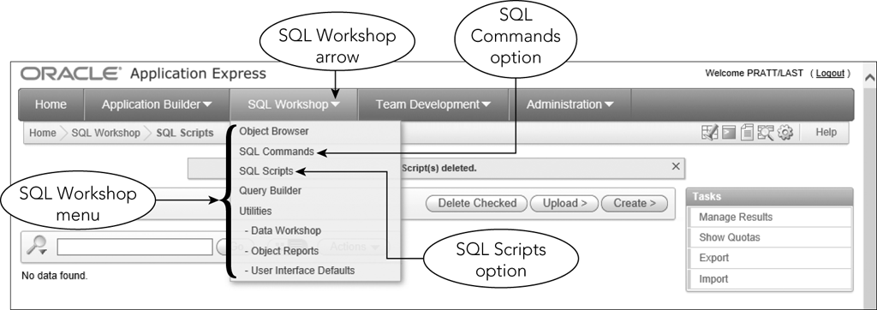
Entering Commands
Figure 3-9: SQL Workshop menu
©2016 Cengage Learning. All Rights Reserved. May not be copied, scanned, or duplicated, in whole or in part, except for use as permitted in a license distributed with a certain product or service or otherwise on a password-protected website for classroom use.

Slide 17
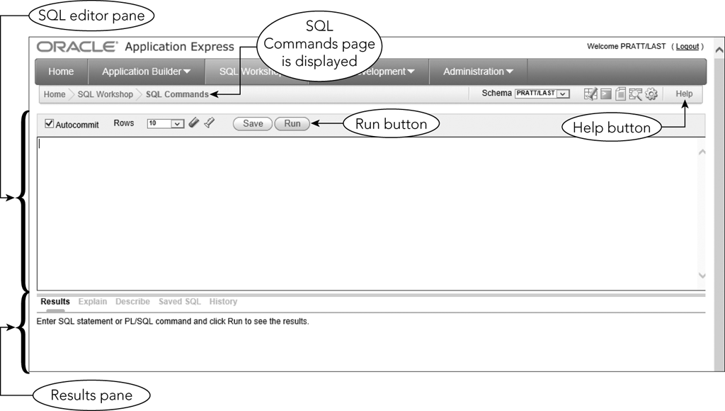
Entering Commands (continued)
Figure 3-10: SQL Commands page
©2016 Cengage Learning. All Rights Reserved. May not be copied, scanned, or duplicated, in whole or in part, except for use as permitted in a license distributed with a certain product or service or otherwise on a password-protected website for classroom use.

Slide 18
Creating a Table
Describe the layout of each table in the database
Use CREATE TABLE command
TABLE is followed by the table name
Follow this with the names and data types of the columns in the table
Data types define type and size of data
©2016 Cengage Learning. All Rights Reserved. May not be copied, scanned, or duplicated, in whole or in part, except for use as permitted in a license distributed with a certain product or service or otherwise on a password-protected website for classroom use.

Slide 19
Creating a Table (continued)
Table and column name restrictions
  Names cannot exceed 30 characters
  Must start with a letter
  Can contain letters, numbers, and underscores (_)
  Cannot contain spaces
©2016 Cengage Learning. All Rights Reserved. May not be copied, scanned, or duplicated, in whole or in part, except for use as permitted in a license distributed with a certain product or service or otherwise on a password-protected website for classroom use.

Slide 20
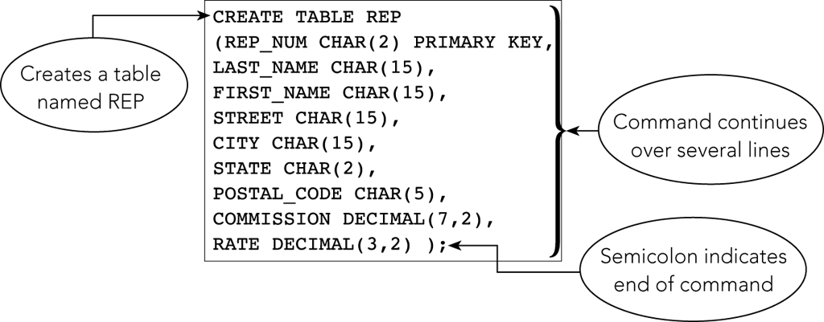
Creating a Table (continued)
Figure 3-11: CREATE TABLE command for the REP table
©2016 Cengage Learning. All Rights Reserved. May not be copied, scanned, or duplicated, in whole or in part, except for use as permitted in a license distributed with a certain product or service or otherwise on a password-protected website for classroom use.

Slide 21
Creating a Table (continued)
Commands are free-format; no rules stating specific words in specific positions
Indicate the end of a command by typing a semicolon
Commands are not case sensitive
In Oracle, enter the command in the SQL editor pane
©2016 Cengage Learning. All Rights Reserved. May not be copied, scanned, or duplicated, in whole or in part, except for use as permitted in a license distributed with a certain product or service or otherwise on a password-protected website for classroom use.

Slide 22
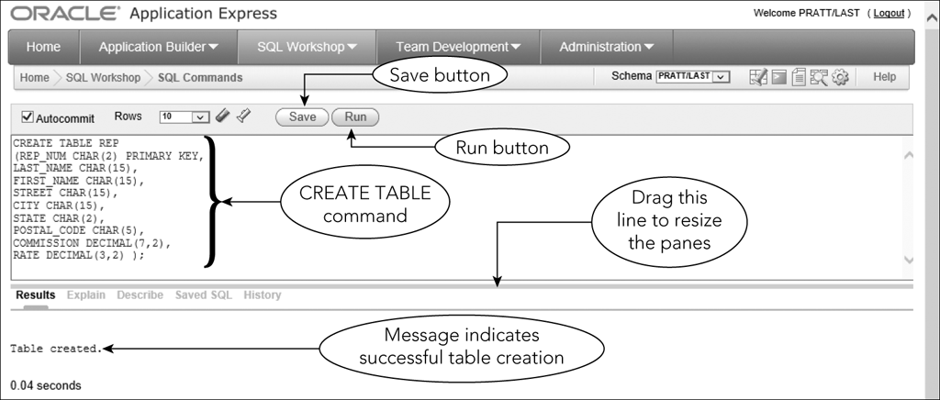
Creating a Table (continued)
Figure 3-12: Running the CREATE TABLE command for the REP table
©2016 Cengage Learning. All Rights Reserved. May not be copied, scanned, or duplicated, in whole or in part, except for use as permitted in a license distributed with a certain product or service or otherwise on a password-protected website for classroom use.

Slide 23
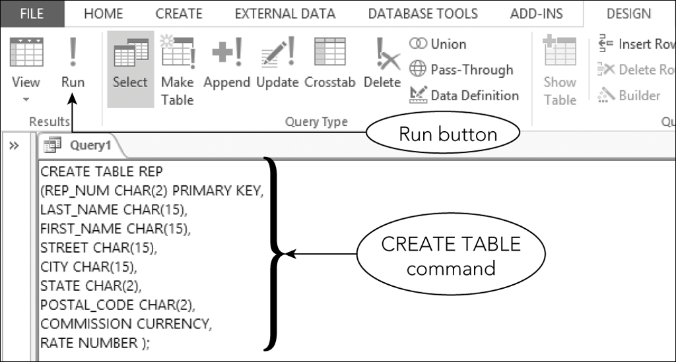
Creating a Table (continued)
Figure 3-13: Using Access SQL view to create a table
©2016 Cengage Learning. All Rights Reserved. May not be copied, scanned, or duplicated, in whole or in part, except for use as permitted in a license distributed with a certain product or service or otherwise on a password-protected website for classroom use.

Slide 24
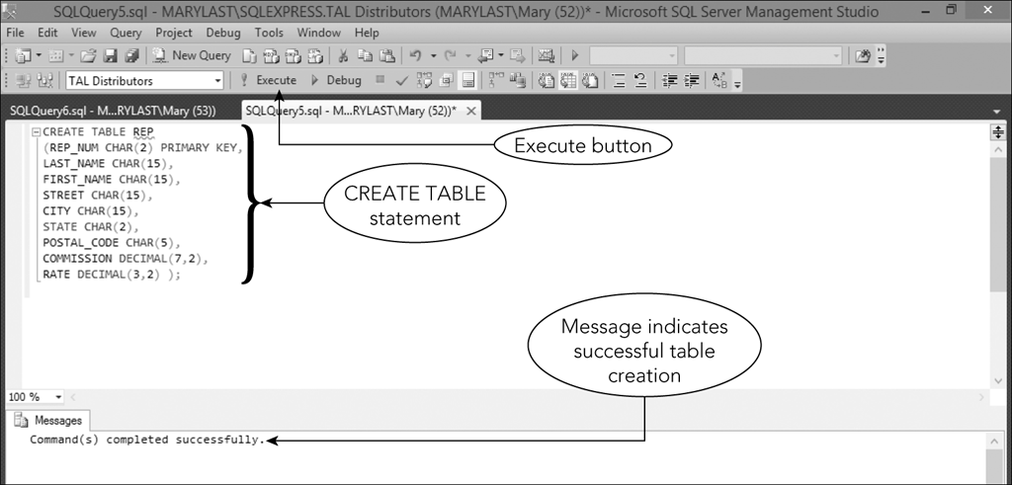
Creating a Table (continued)
Figure 3-14: Using Microsoft SQL Server to create a table
©2016 Cengage Learning. All Rights Reserved. May not be copied, scanned, or duplicated, in whole or in part, except for use as permitted in a license distributed with a certain product or service or otherwise on a password-protected website for classroom use.

Slide 25
Correcting Errors in SQL Commands
Use the same techniques that you might use in a word processor
Make changes and click Run button to execute command again
Check Results pane to determine if command executed successfully
©2016 Cengage Learning. All Rights Reserved. May not be copied, scanned, or duplicated, in whole or in part, except for use as permitted in a license distributed with a certain product or service or otherwise on a password-protected website for classroom use.

Slide 26
Dropping a Table
Can correct errors by dropping (deleting) a table and starting over
Useful when table is created before errors are discovered
Command is followed by the table to be dropped and a semicolon
Any data in table also deleted
©2016 Cengage Learning. All Rights Reserved. May not be copied, scanned, or duplicated, in whole or in part, except for use as permitted in a license distributed with a certain product or service or otherwise on a password-protected website for classroom use.

Slide 27
Using Data Types
For each column, the type of data must be defined
Common data types
  CHAR(n)
  VARCHAR(n)
  DATE
  DECIMAL(p,q)
  INT
  SMALLINT
©2016 Cengage Learning. All Rights Reserved. May not be copied, scanned, or duplicated, in whole or in part, except for use as permitted in a license distributed with a certain product or service or otherwise on a password-protected website for classroom use.

Slide 28
Using Nulls
A special value to represent a situation when the actual value is not known for a column
Can specify whether to allow nulls in the individual columns
Should not allow nulls for primary key columns
©2016 Cengage Learning. All Rights Reserved. May not be copied, scanned, or duplicated, in whole or in part, except for use as permitted in a license distributed with a certain product or service or otherwise on a password-protected website for classroom use.

Slide 29
Using Nulls (continued)
Use NOT NULL clause in CREATE TABLE command to exclude the use of nulls in a column
Default is to allow null values
If a column is defined as NOT NULL, system will reject any attempt to store a null value there
©2016 Cengage Learning. All Rights Reserved. May not be copied, scanned, or duplicated, in whole or in part, except for use as permitted in a license distributed with a certain product or service or otherwise on a password-protected website for classroom use.

Slide 30
Using Nulls (continued)
CREATE TABLE REP
(REP_NUM CHAR(2) PRIMARY KEY,
LAST_NAME CHAR(15) NOT NULL,
FIRST_NAME CHAR(15) NOT NULL,
STREET CHAR(15),
CITY CHAR(15),
STATE CHAR(2),
POSTAL_CODE CHAR(5),
COMMISSION DECIMAL(7,2),
RATE DECIMAL(3,2) );
©2016 Cengage Learning. All Rights Reserved. May not be copied, scanned, or duplicated, in whole or in part, except for use as permitted in a license distributed with a certain product or service or otherwise on a password-protected website for classroom use.

Slide 31
Adding Rows to a Table
INSERT Command
  INSERT INTO followed by table name
  VALUES command followed by specific values in parentheses
  Values for character columns in single quotation marks
©2016 Cengage Learning. All Rights Reserved. May not be copied, scanned, or duplicated, in whole or in part, except for use as permitted in a license distributed with a certain product or service or otherwise on a password-protected website for classroom use.

Slide 32
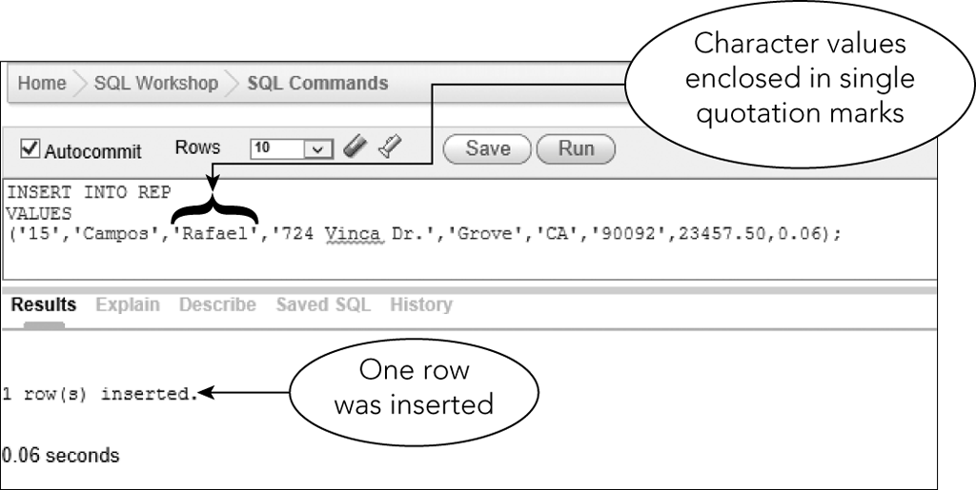
The Insert Command
Figure 3-17: INSERT command for the first record in the REP table
©2016 Cengage Learning. All Rights Reserved. May not be copied, scanned, or duplicated, in whole or in part, except for use as permitted in a license distributed with a certain product or service or otherwise on a password-protected website for classroom use.

Slide 33
The INSERT Command (continued)
To add new rows, modify previous insert command
Use same editing techniques as those used to correct errors
©2016 Cengage Learning. All Rights Reserved. May not be copied, scanned, or duplicated, in whole or in part, except for use as permitted in a license distributed with a certain product or service or otherwise on a password-protected website for classroom use.

Slide 34
Inserting a Row that Contains Nulls
Use a special format of INSERT command to enter a null value in a table
Identify the names of the columns that accept non-null values and then list only the non-null values after the VALUES command
©2016 Cengage Learning. All Rights Reserved. May not be copied, scanned, or duplicated, in whole or in part, except for use as permitted in a license distributed with a certain product or service or otherwise on a password-protected website for classroom use.

Slide 35
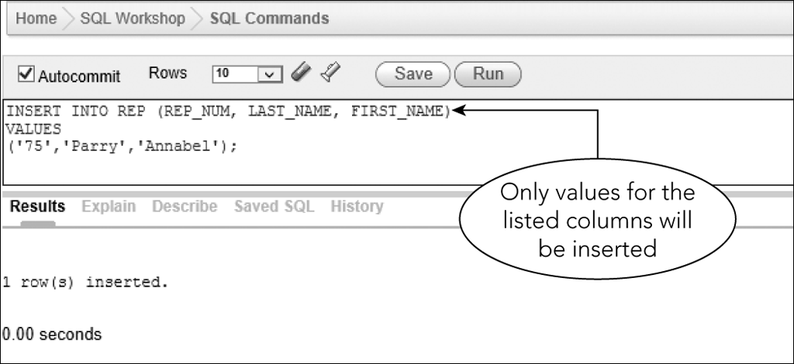
Inserting a Row that Contains Nulls (continued)
Figure 3-20: Inserting a row that contains null values in the REP table
©2016 Cengage Learning. All Rights Reserved. May not be copied, scanned, or duplicated, in whole or in part, except for use as permitted in a license distributed with a certain product or service or otherwise on a password-protected website for classroom use.

Slide 36
Viewing Table Data
Use SELECT command
  Can display all the rows and columns in a table
SELECT * FROM followed by the name of the table
Ends with a semicolon
©2016 Cengage Learning. All Rights Reserved. May not be copied, scanned, or duplicated, in whole or in part, except for use as permitted in a license distributed with a certain product or service or otherwise on a password-protected website for classroom use.

Slide 37
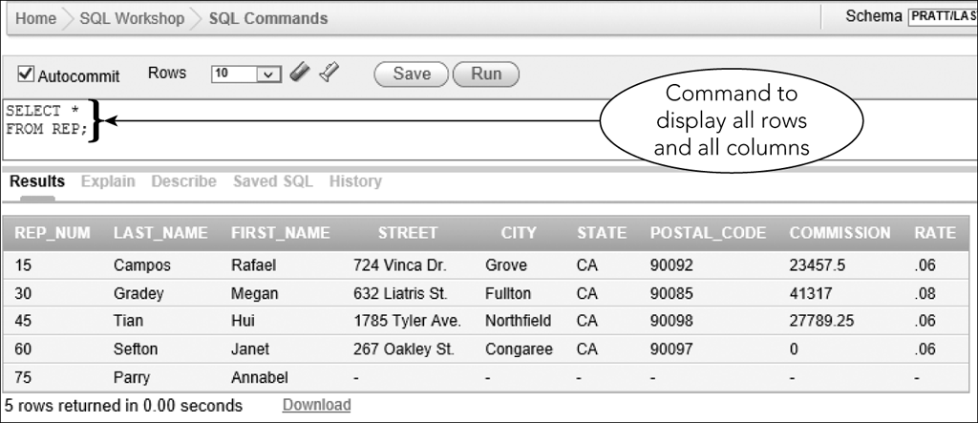
Viewing Table Data (continued)
Figure 3-21: Using a SELECT command to view table data
©2016 Cengage Learning. All Rights Reserved. May not be copied, scanned, or duplicated, in whole or in part, except for use as permitted in a license distributed with a certain product or service or otherwise on a password-protected website for classroom use.

Slide 38
Viewing Table Data (continued)
In Access
  Enter SELECT statement in SQL view
In SQL Server
  Enter SELECT statement in Query Editor window
©2016 Cengage Learning. All Rights Reserved. May not be copied, scanned, or duplicated, in whole or in part, except for use as permitted in a license distributed with a certain product or service or otherwise on a password-protected website for classroom use.

Slide 39
Correcting Errors in a Table
UPDATE command is used to update a value in a table
DELETE command allows you to delete a record
INSERT command allows you to add a record
©2016 Cengage Learning. All Rights Reserved. May not be copied, scanned, or duplicated, in whole or in part, except for use as permitted in a license distributed with a certain product or service or otherwise on a password-protected website for classroom use.

Slide 40
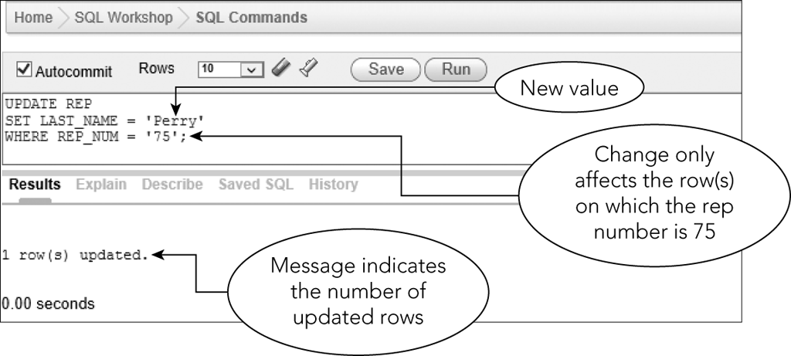
Correcting Errors in a Table (continued)
Figure 3-26: Using an UPDATE command to change a value
©2016 Cengage Learning. All Rights Reserved. May not be copied, scanned, or duplicated, in whole or in part, except for use as permitted in a license distributed with a certain product or service or otherwise on a password-protected website for classroom use.

Slide 41
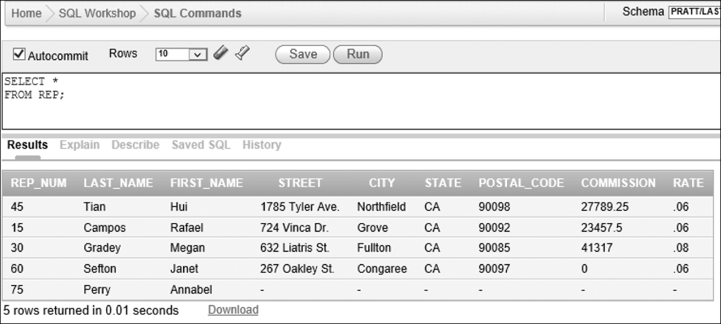
Correcting Errors in a Table (continued)
Figure 3-27: Last name changed for sales rep number 75
©2016 Cengage Learning. All Rights Reserved. May not be copied, scanned, or duplicated, in whole or in part, except for use as permitted in a license distributed with a certain product or service or otherwise on a password-protected website for classroom use.

Slide 42
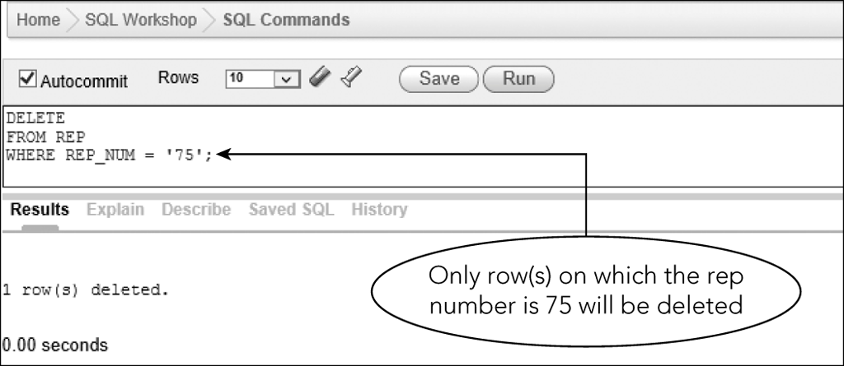
Correcting Errors in a Table (continued)
Figure 3-28: Using a DELETE command to delete a row
©2016 Cengage Learning. All Rights Reserved. May not be copied, scanned, or duplicated, in whole or in part, except for use as permitted in a license distributed with a certain product or service or otherwise on a password-protected website for classroom use.

Slide 43
Saving SQL Commands
Allows you to use commands again without retyping
Save commands in a script file or script
  Text file with .sql extension
Script repository
  Special location in Oracle
  Can download to local drive
©2016 Cengage Learning. All Rights Reserved. May not be copied, scanned, or duplicated, in whole or in part, except for use as permitted in a license distributed with a certain product or service or otherwise on a password-protected website for classroom use.

Slide 44
Saving SQL Commands (continued)
To create a script file in Oracle:
  Use Script Editor page
  Enter a name for script
  Type the command or commands to save in script
  Save the script
©2016 Cengage Learning. All Rights Reserved. May not be copied, scanned, or duplicated, in whole or in part, except for use as permitted in a license distributed with a certain product or service or otherwise on a password-protected website for classroom use.

Slide 45
Saving SQL Commands (continued)
Once a script file is created:
  Can view, edit, or run
  Can delete
  Can download from script repository to local drive
  Can upload from local drive to script repository
©2016 Cengage Learning. All Rights Reserved. May not be copied, scanned, or duplicated, in whole or in part, except for use as permitted in a license distributed with a certain product or service or otherwise on a password-protected website for classroom use.

Slide 46
Saving SQL Commands (continued)
Access
  Does not use script files
  Save SQL commands as query objects
SQL Server
  Can create scripts
  Can view, edit, run scripts
  Can delete scripts
©2016 Cengage Learning. All Rights Reserved. May not be copied, scanned, or duplicated, in whole or in part, except for use as permitted in a license distributed with a certain product or service or otherwise on a password-protected website for classroom use.

Slide 47
Creating the Remaining Database Tables
Execute appropriate CREATE TABLE and INSERT commands
Save these commands as scripts
Separate multiple commands in a script file with a semicolon
Figures 3-30 through 3-37 give additional table information for TAL Distributors
©2016 Cengage Learning. All Rights Reserved. May not be copied, scanned, or duplicated, in whole or in part, except for use as permitted in a license distributed with a certain product or service or otherwise on a password-protected website for classroom use.

Slide 48
Describing a Table
DESCRIBE command (Oracle)
Documenter tool (Access)
Exec sp_columns command (SQL Server)
©2016 Cengage Learning. All Rights Reserved. May not be copied, scanned, or duplicated, in whole or in part, except for use as permitted in a license distributed with a certain product or service or otherwise on a password-protected website for classroom use.

Slide 49
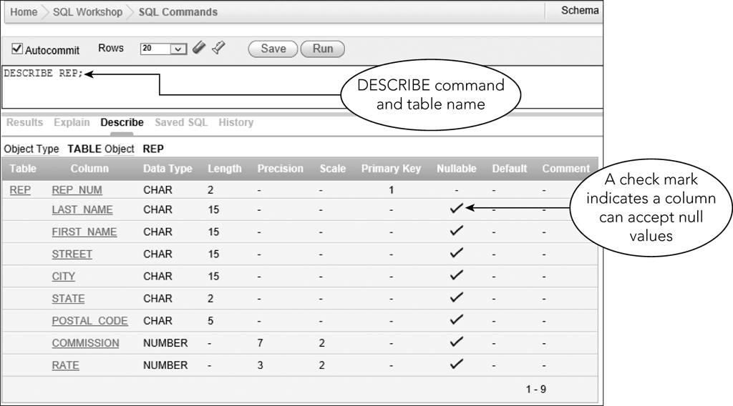
Describing a Table (continued)
Figure 3-38: DESCRIBE command for the REP table
©2016 Cengage Learning. All Rights Reserved. May not be copied, scanned, or duplicated, in whole or in part, except for use as permitted in a license distributed with a certain product or service or otherwise on a password-protected website for classroom use.

Slide 50
Summary
Use the CREATE TABLE command to create tables
Use the DROP TABLE command to delete a table
CHAR, VARCHAR, DATE, DECIMAL, INT, and SMALLINT data types
  Access does not support DECIMAL
©2016 Cengage Learning. All Rights Reserved. May not be copied, scanned, or duplicated, in whole or in part, except for use as permitted in a license distributed with a certain product or service or otherwise on a password-protected website for classroom use.

Slide 51
Summary (continued)
Null value used when actual value for a column is unknown, unavailable, or not applicable
Use NOT Null clause to identify columns that cannot have a null value
Use INSERT command to add rows
Use SELECT command to view data in a table
©2016 Cengage Learning. All Rights Reserved. May not be copied, scanned, or duplicated, in whole or in part, except for use as permitted in a license distributed with a certain product or service or otherwise on a password-protected website for classroom use.

Slide 52
Summary (continued)
Use UPDATE command to change the value in a column
Use DELETE command to delete a row
Save SQL commands in a script file
Use DESCRIBE command to display a table’s structure
©2016 Cengage Learning. All Rights Reserved. May not be copied, scanned, or duplicated, in whole or in part, except for use as permitted in a license distributed with a certain product or service or otherwise on a password-protected website for classroom use.

